Slide 1
JavaFX
New Java API for GUI development
Can reference APIs from any Java library (e.g. native system capabilities, connect to server-based middleware apps)
Look and Feel can be customized using Cascading Style Sheets (CSS) allowing separation of appearance/style from code

Slide 2
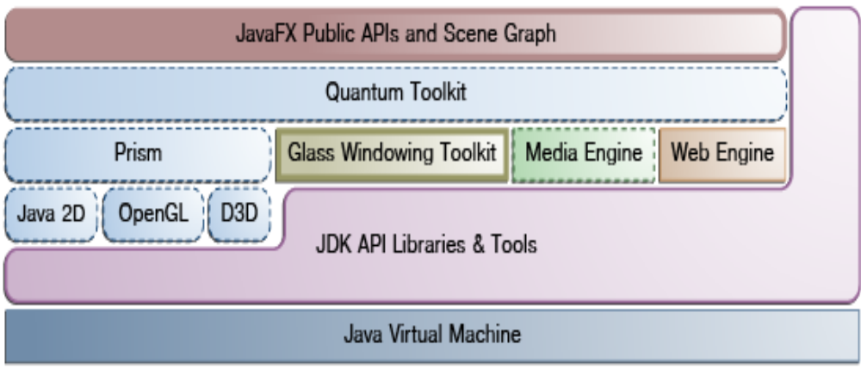
JavaFX Architecture

Slide 3
Scene Graph
Hierarchical tree of nodes that represent all of the visual elements of the UI
A single element in a scene graph is called a node
Nodes have an ID, style class, and bounding volume, a single parent (except root node) and 0+ children
Scene API allows creation of content – Nodes (2D,3D), images, text, UI controls, charts, groups, containers; State - transforms (position, orientation of nodes), visual effects; Effects – blurs, shadows, color

Slide 4
JavaFX Graphics System
Supports 2D and 3D scene graphs, software rendering where graphics hardware does not
Prism processes render jobs (rasterization and rendering of JavaFX scenes) using DirectX or OpenGL

Slide 5
Glass Windowing Toolkit
Provides native operating services such as managing windows, timers, and surfaces
Platform-dependent layer connecting JavaFX to O/S
Maintains event queue (but uses the native O/S event queue for thread scheduling)
Glass runs on the same thread as JavaFX application

Slide 6
Threads
JavaFX application thread – primary thread used by JavaFX application. Any “live” scene (part of a window) must be accessed from this thread. Scene graph can be created and manipulated in a background thread, but when root not is attached to any live object in the scene, scene graph must be accessed from JavaFX application thread.
Prism render thread – handles rendering from event dispatcher allowing frame N to be rendered while frame N+1 is being processed
Media thread – runs in background and synchronizes latest frames thru scene graph using application thread

Slide 7
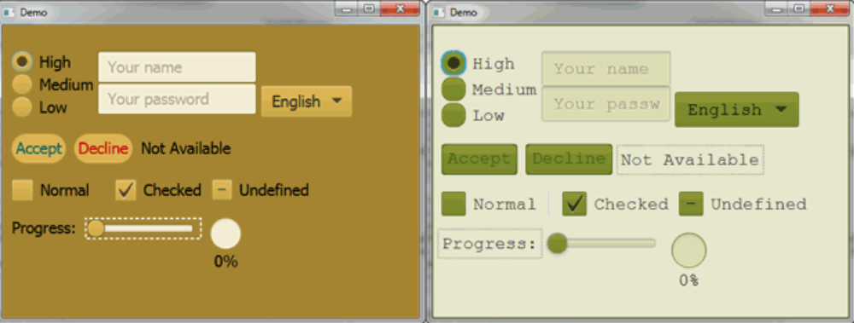
CSS

Slide 8
JavaFX Cascading Style Sheets
As shown above, provides ability to apply customized styling to UI without changing source code
CSS can be applied to any node in JavaFX scene graph and can be applied at runtime

Slide 9
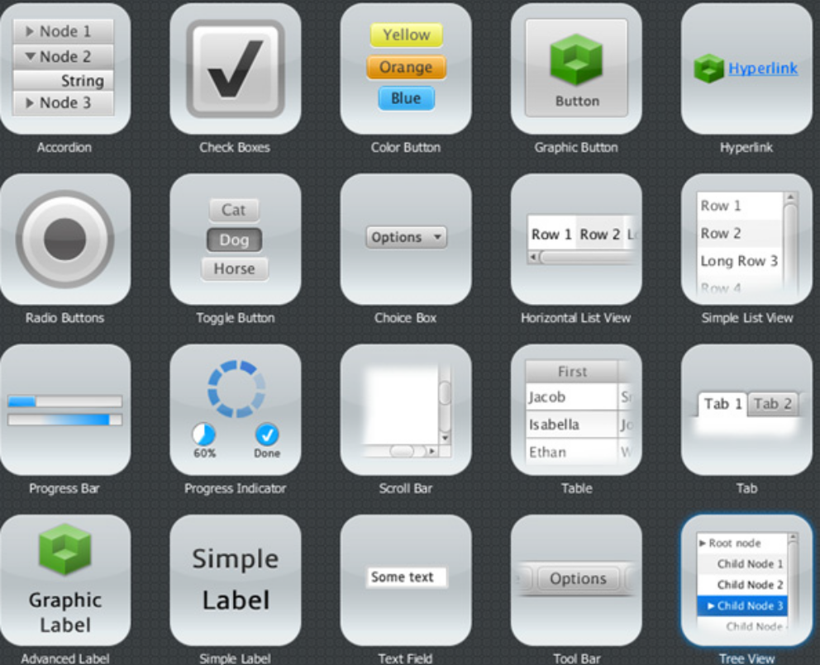
UI Controls
Built using nodes in scene graph

Slide 10
Layout
Layout containers or panes can be used for flexible and dynamic arrangements of UI controls within a scene graph
BorderPane class lays content top, bottom, right, left, center
Hbox class arranges content horizontally in a single row
Vbox class similar but vertically
StackPane class back-to-front
GridPane class in a grid of rows/columns
FlowPane class content is horizontal or vertical wrapping at specified width/height
TilePane class content is in uniformly sized layout cells or tiles
AnchorPane class anchors nodes to top, bottom, left or center

Slide 11
JavaFX Applications
See HelloWorld example
Entry point is “start()” method not main()
UI container is defined by stage and scene
Stage class is top-level JavaFX container
Scene class is container for all content
A Stage can have a Window owner. Whatever happens to the Window owner happens to the Stage thus if a parent Window is closed all of it’s descendent windows are closed etc.

Slide 12
Nodes: Stage, scene, controls
Think of a Stage as a window (thus a container) – it’s not exactly that though
Think of a scene as the hierarchical scene graph of nodes or as a layout manager – it’s also not really a layout manager
When the root node (layout) is resized, the scene is adjusted as needed

Slide 13
main()
Not needed
If used must call launch() method
Useful if you create JAR files without JavaFX Launcher, Swing applications etc

Slide 14
Event
In a similar manner to Swing and AWT event handling is done with a listener
Events: Mouse, Key, Drag, Window
Events have a:
  Target – node the event occurred (Window,scene, and node)
  Source – what caused the event (Mouse, Key, etc)
  Type – type of event (e.g. mouse pressed, key down, etc)

Slide 15
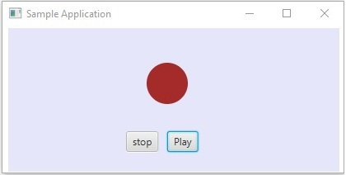
Example GUI for Events

Slide 16
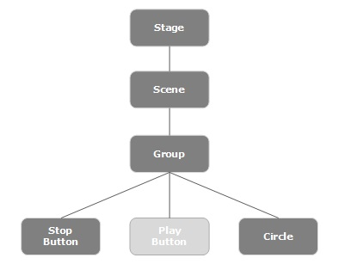
Event chain example

Slide 17
Event Handling
Events travel to all the Nodes in the dispatch chain (top to bottom)
As the event travels down the chain any node can have a filter registered to handle the event
If no filter handles the event then it reaches the target and is handled (if yes it does NOT move down)
The event then “bubbles” from the target up to the root node.
Any node can have an Event Handler registered to the event to handle the event on the way up

Slide 18
More on JavaFX
Read up on JavaFX online at Oracle webpages as needed

